Slide 1
Project
Flight Ticket Price Prediction

Slide 2
Problem Statement and Understanding
Anyone who has booked a flight ticket knows how unexpectedly the prices vary. The cheapest available ticket on a given flight gets more and less expensive over time. This usually happens as an attempt to maximize revenue based on –
Time of purchase patterns (making sure last-minute purchases are expensive)
Keeping the flight as full as they want it (raising prices on a flight which is filling up in order to reduce sales and hold back inventory for those expensive last-minute expensive purchases)
There are lot of changes in the aviation business with respect to their prices of tickets. Because of this people who are booking flight tickets are suffering the most, hence we are building a flight price prediction model to predict the price of flight ticket. This model will help the travelers to buy flight tickets with cheaper price.

Slide 3
EDA Steps
Identifying sources of the data
Data collection
Data structuring
Analyzing the data
Cleaning and processing the data
Selecting most important features
Writing down findings and observations
Using different models to train the data
Selecting best fitted model for predictions
Predicting outcome for test data

Slide 4
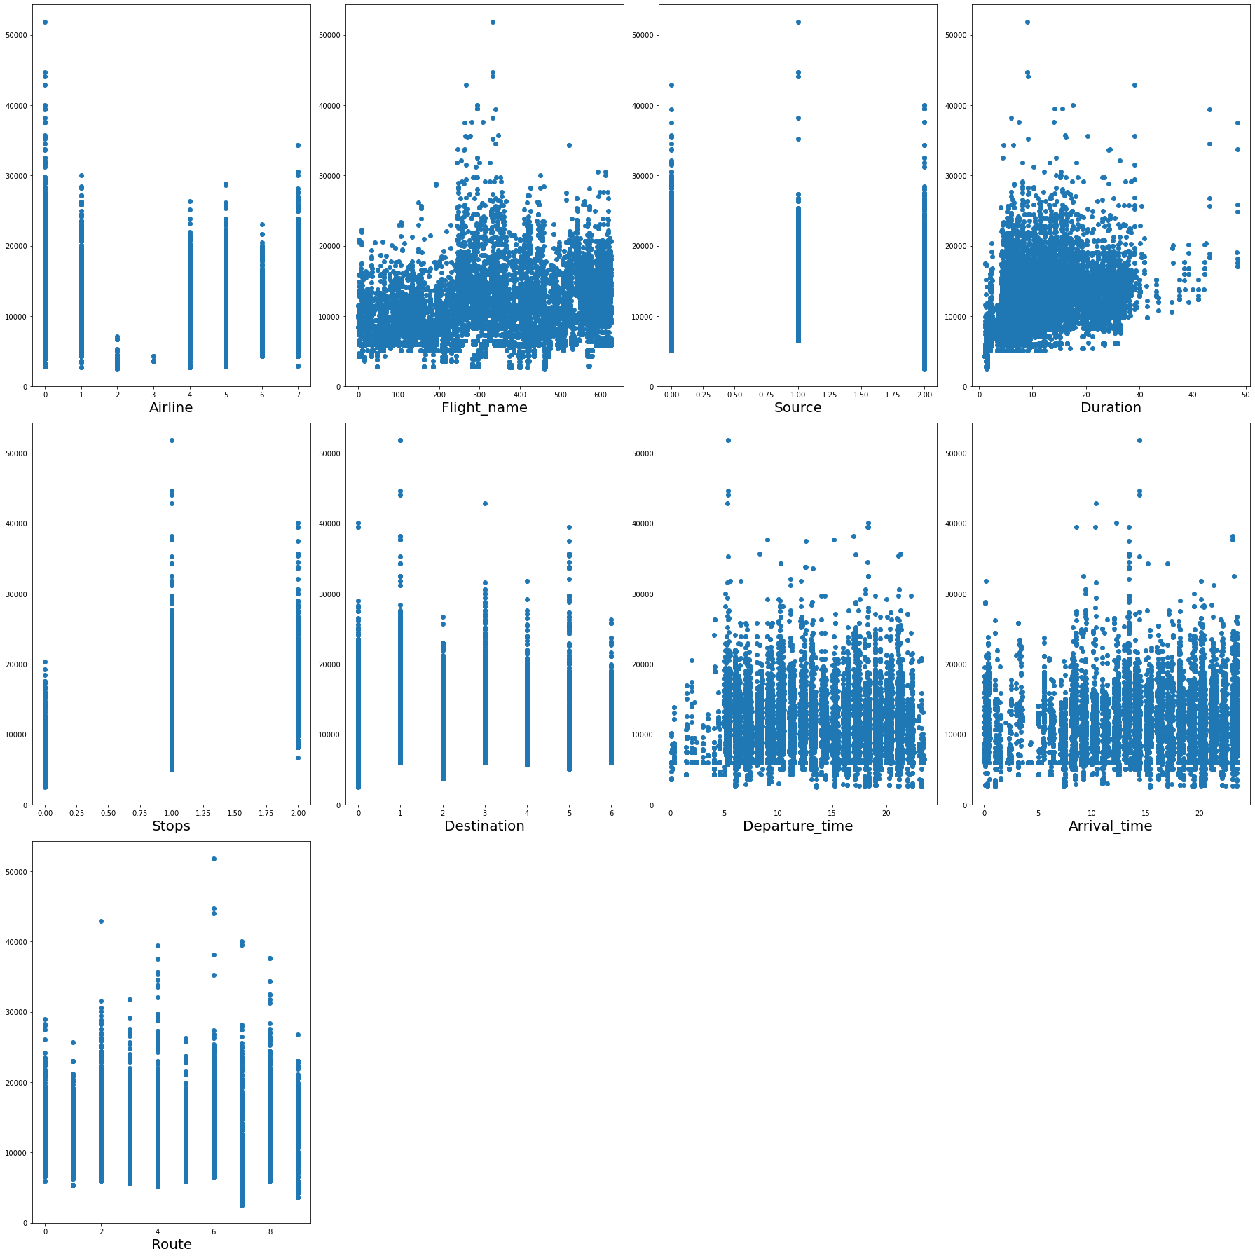
Visualizations
Scatter Plot: -
Observations:
• Duration and Stops columns have high co-relation with Label.
• Airline, Arrival_time and Departure_time columns have Low/No co-relation with Label.

Slide 5
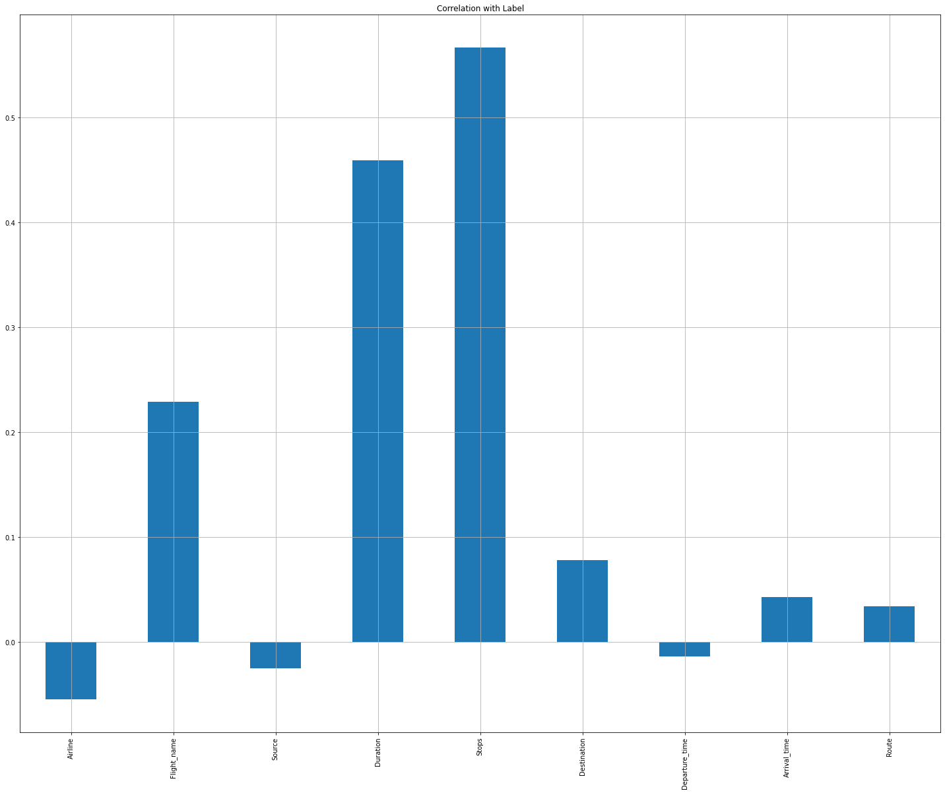
Visualizations
2. BarPlot: -
Observations:
• Duration and Stops columns have high co-relation with Label.
• Airline, Arrival_time and Departure_time columns have Low/No co-relation with Label.

Slide 6
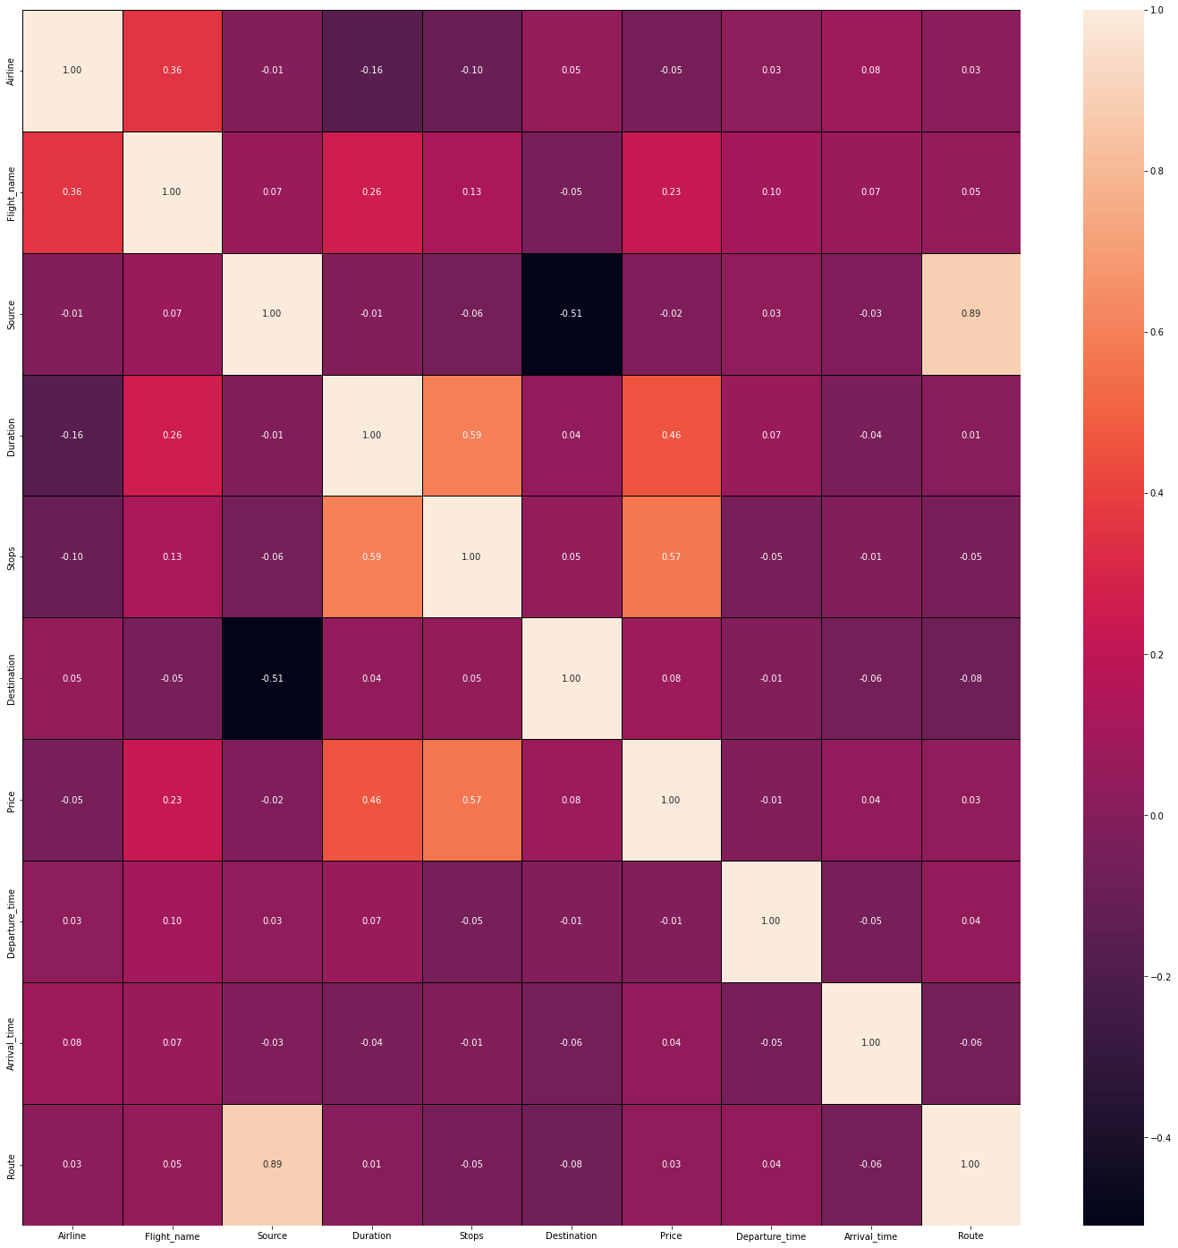
Visualizations
3. HeatMap: -
Observations:
Multicollinearity problem does not exist in this database

Slide 7
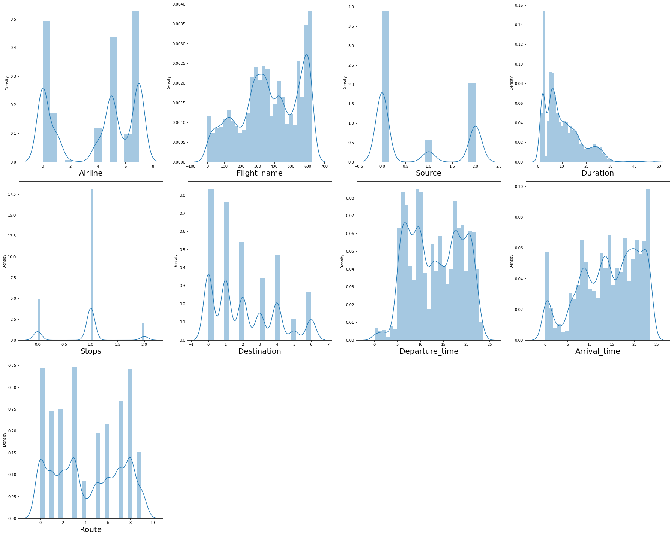
Visualizations
4. Distribution Plot: -
Observations:
• Not considering skewness of categorical data columns.
• Duration column has skewness

Slide 8
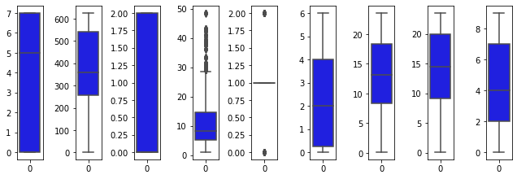
Visualizations
5. Box Plot: -
Observations:
• Duration Column has outliers.

Slide 9
Steps and Assumptions
Clean and organized the data.
Checked the data type of each column.
Changed the Object data type to Integer.
Checked whether the data has any Null Values and fill those Null values using Mean and Mode method.
Checked whether the data is categorical data or continuous data.
There are many categorical columns which has same output with different variable so standardized the data.
E.g: - In ‘Stops’ column
'1-stop':1,
'non-stop':0,
'2+-stop':2,
'1-stop Via IDR':1,
'1-stop Via Indore':1,
'1-stop Via RPR':1,
'1-stop Via Guwahati':1,
'1-stop Via Ahmedabad':1,
'1-stop Via CNN':1,
'1-stop Via VNS':1,
'1-stop Via VTZ':1
Encoded remaining Object data type columns to integer using encoder technique.
Checked the co-relation of features with label i.e Price.
Checked the Multicollinearity between features.
Checked the VIF score of features.
Checked the Distribution of data.
Identified and removed outliers those are not allowed above and below the specific limit.

Slide 10
Model Dashboard
Identification of possible problem
The data was not structured and organized hence cleaned the data using various data cleaning and pre-processing techniques.
There are many outliers present in the data hence removed outliers
There was a skewness in the data hence have removed the skewness from the data.
Scaled the data using Standard Scalar to make the data standardized to build a model.
Testing of Identified Approaches
These are the algorithms which have been used to train and test data.
LinearRegression
DecisionTreeRegressor
AdaBoostRegressor
GradientBoostingRegressor
RandomForestRegressor
KNeighborsRegressor
Support Vector Regression

Slide 11
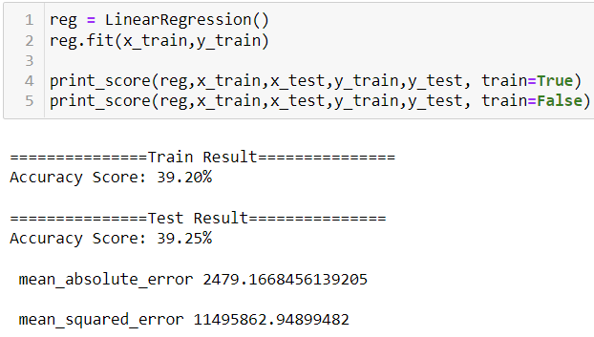
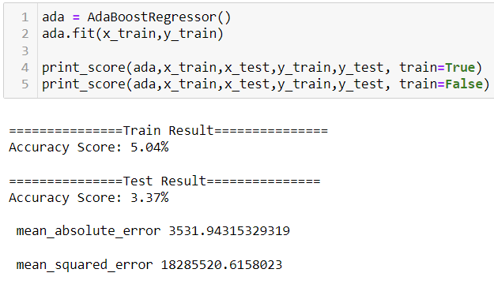
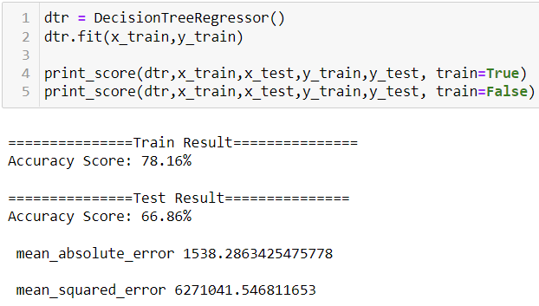
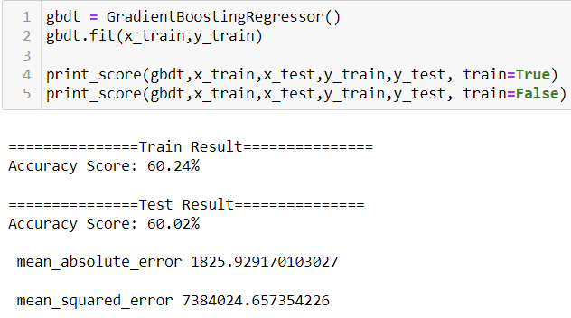
Model Dashboard
1. LinearRegression: -
2. DecisionTreeRegressor: -
3. AdaBoostRegressor: -
4. GradientBoostingRegressor: -

Slide 12
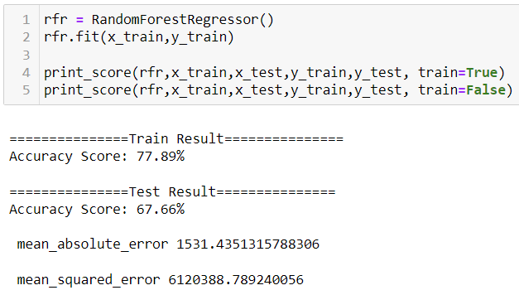
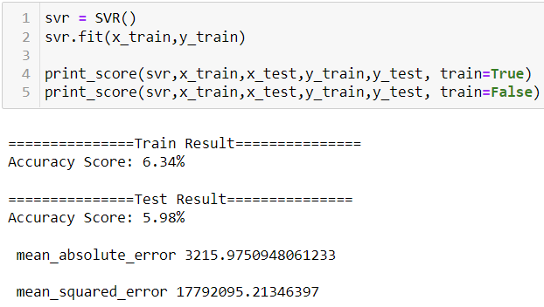

Model Dashboard
5. RandomForestRegressor: -
6. KNeighborsRegressor: -
7. Support Vector Regression: -

Slide 13
Finalized Model
Key Findings and Conclusions of the Model
Selecting GradientBoostingRegressor model since the Accuracy score i.e., 60.24% and test scores i.e., 60.02% are greater and close to each other.
mean_absolute_error is moderate for GradientBoostingRegressor model.

Slide 14
Conclusion
Interpretation of the Results
Below is the list of highly influencing features or variables to predict the flight price.
1. Duration – Duration is very important feature in order to predict flight ticket price.
2. Stops – Stops column is also very important as flight ticket price depends upon the stops.
Data Findings.
1. Vistara has the highest average price of flight ticket following by Air India and AirAsia.
2. AllianceAir has the lowest flight average ticket price following by AkasaAir and Indigo.
3. Delhi to Kolkata has the highest flight price whereas Mumbai to Bangalore has lowest.
4. 23.25 is the best time to depart towards the destination as it has the lowest price of flight ticket.
5. 11.45 is the best time to arrive on destination as it has the lowest price of flight ticket.

Slide 15
Conclusion
Learning Outcomes of the Study in respect of Data Science
Data Cleaning helps to convert unorganized and unstructured data into structured data which will be used to make findings.
Data visualization helps understand and analyse the data.
Model building helps to predict outcomes, in this case GradientBoostingRegressor model fits perfect for this dataset.

